Slide 1
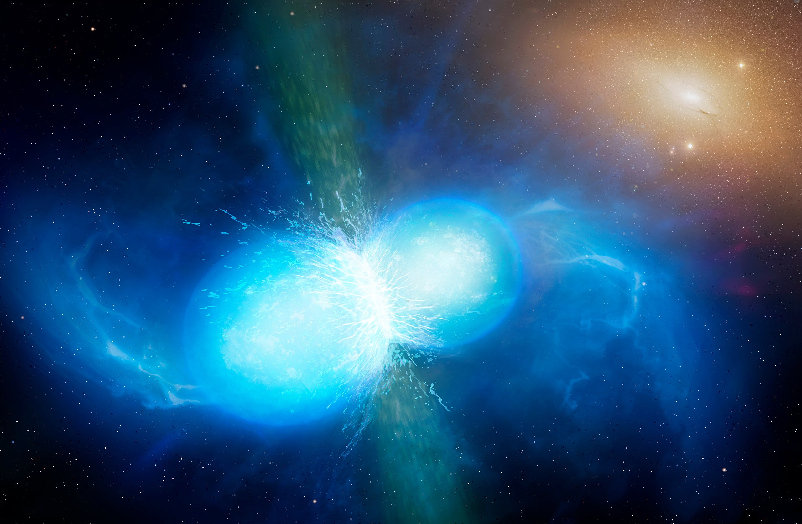
Finding NEMO: Optimising a neutron star extreme matter observatory
Justin Yu (juyu0917@uni.sydney.edu.au)
Supervisor: Bram Slagmolen
University of Warwick/Mark Garlick, CC BY 4.0 <https://creativecommons.org/licenses/by/4.0>, via Wikimedia Commons

Slide 2
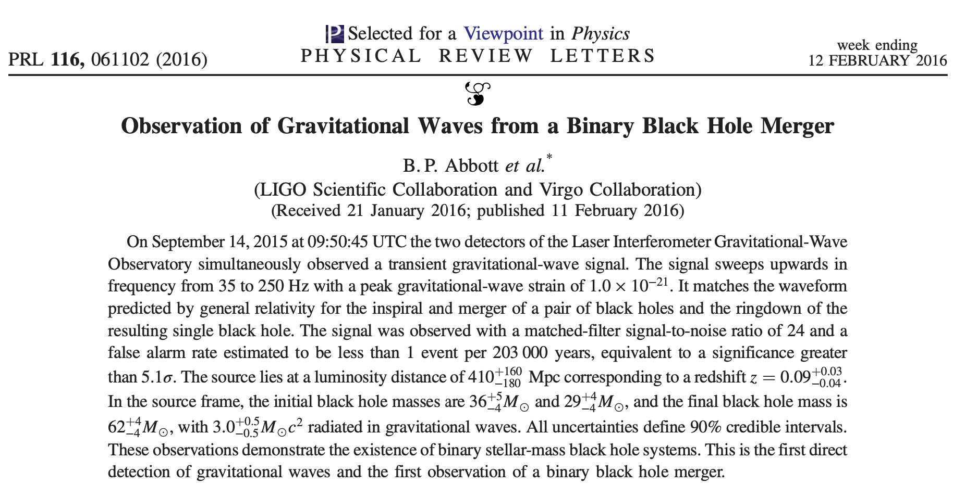
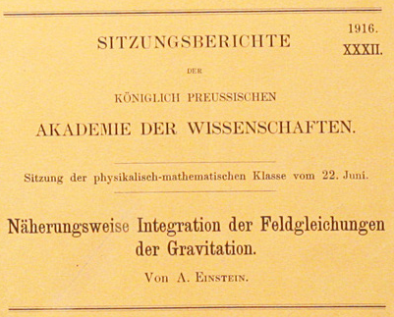
Background

Slide 3
Neutron Star Extreme Matter Observatory (NEMO)
Binary neutron star post-merger oscillations
Depend on unknown equation of state (EoS)
Extreme nuclear physics! e.g. hadron-quark phase transition
Multi-messenger astronomy
Current detectors not sensitive in kHz
NEMO concept sensitive in 1-4kHz band
https://www.youtube.com/watch?v=Dyn9KbB_zeo

Slide 4
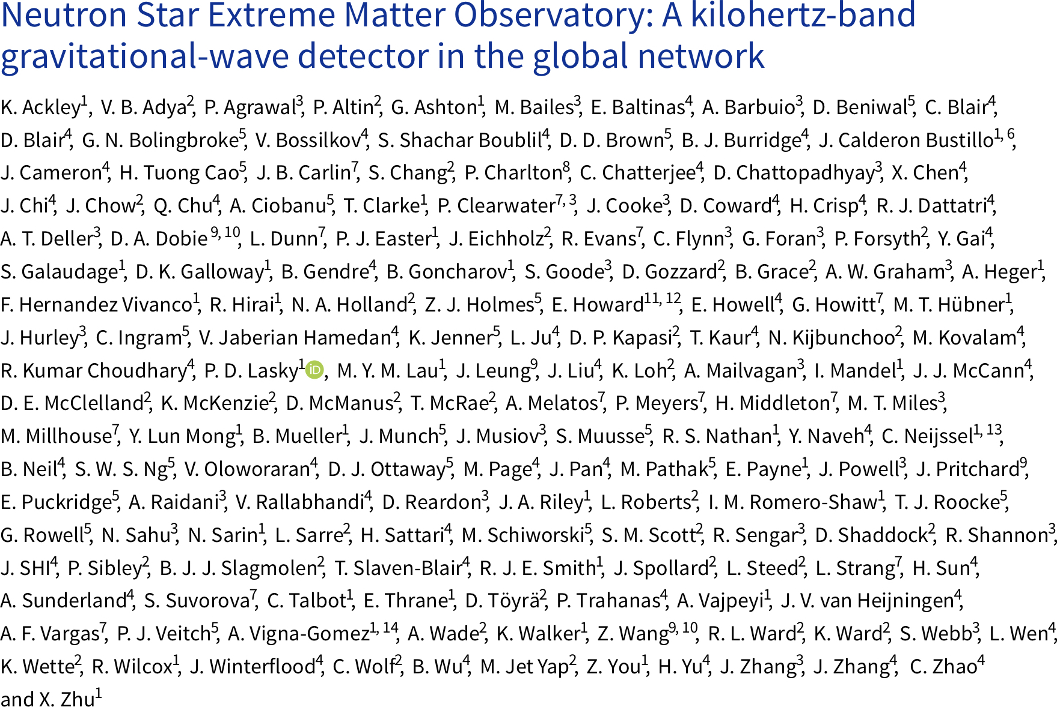
Neutron Star Extreme Matter Observatory (NEMO)
Binary neutron star post-merger oscillations
Depend on unknown equation of state (EoS)
Extreme nuclear physics! e.g. hadron-quark phase transition
Multi-messenger astronomy
Current detectors not sensitive in kHz
NEMO concept sensitive in 1-4kHz band

Slide 5
Detecting gravitational waves
Basic idea
Michelson interferometer experiences differential arm length change
Optical path length difference creates interference
Signal “sidebands” in frequency domain
https://www.youtube.com/watch?v=UA1qG7Fjc2A

Slide 6
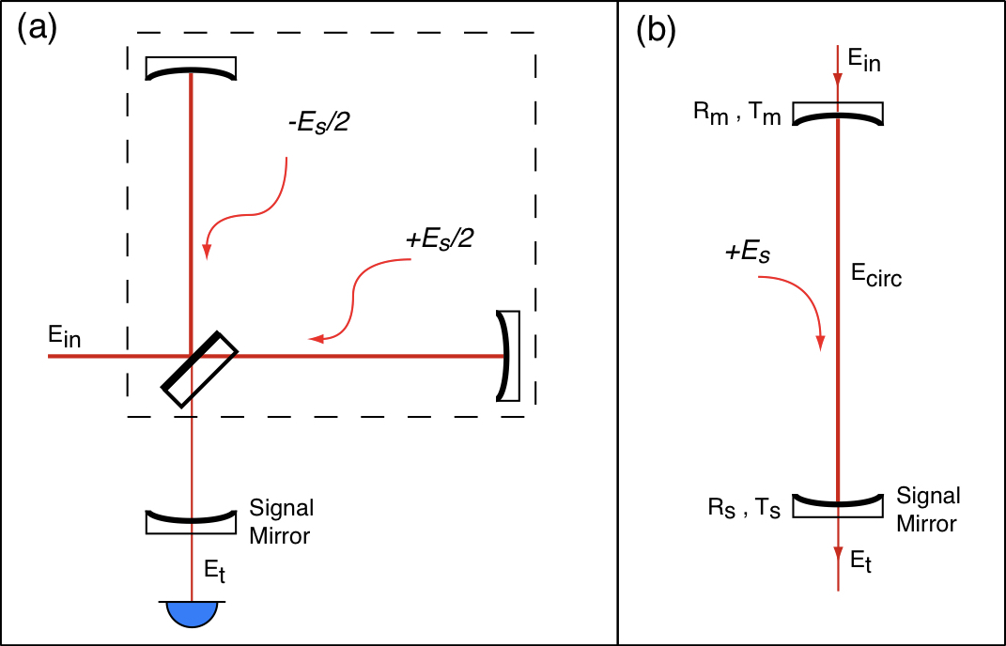
Detecting gravitational waves
Signal recycling
Add mirror (SRM) in front of output port to form signal recycling cavity
Signal sidebands resonantly enhanced
Tuning (microscopic displacement offset) and transmittivity change resonance
Figure 2.2 from de Vine, G – Variable Reflectivity Mirrors for Signal Recycled Michelson Interferometer Gravitational Wave Detectors (2001) (Honours thesis)

Slide 7
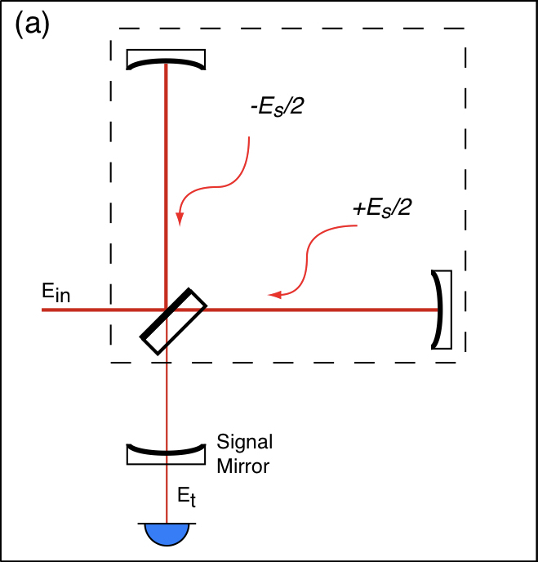
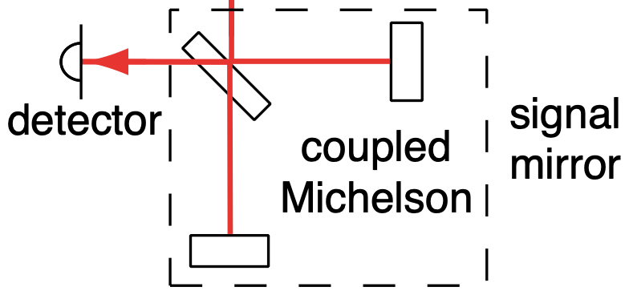
Detecting gravitational waves
Variable reflectivity mirror
Another Michelson can act as a variable-reflectivity mirror (vSRM)
Tunable sensitivity!
Adapted from Figure 2.9 from de Vine, G – Variable Reflectivity Mirrors for Signal Recycled Michelson Interferometer Gravitational Wave Detectors (2001) (Honours thesis)

Slide 8
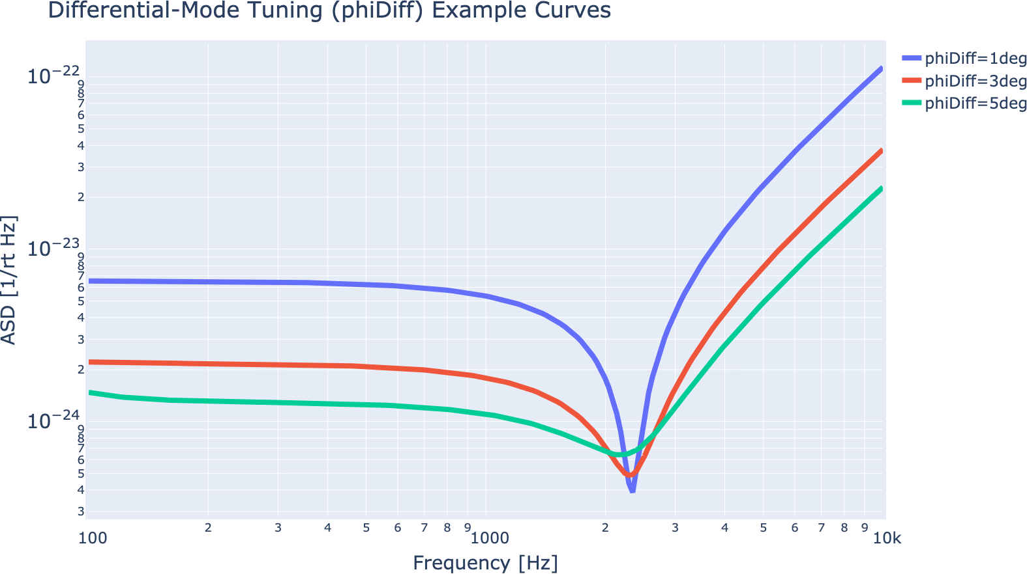
Optimising NEMO
Model detector configurations
Inject NR waveforms
Calculate detection rate
Aim Maximise BNS post-merger signal detection rate
Parameters
vSRM Common mode tuning
vSRM Differential mode tuning (varies reflectivity)
SRC length
ITM transmittivity

Slide 9
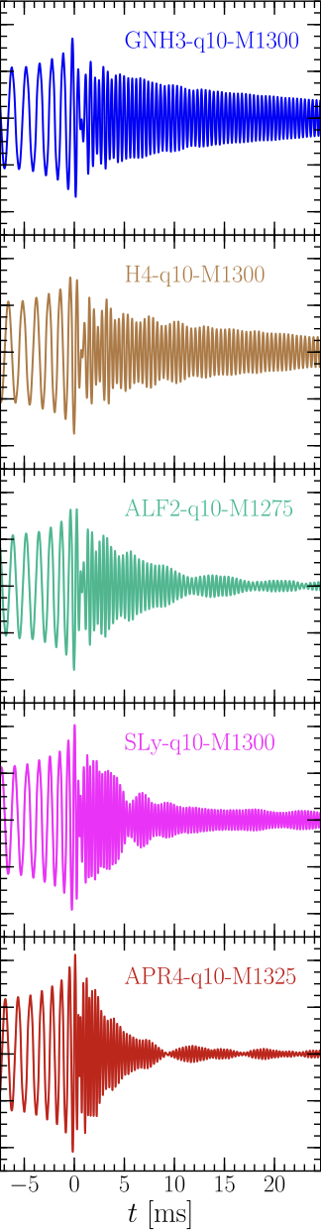
Optimising NEMO
Model detector configurations
Inject NR waveforms
Calculate detection rate
Aim Maximise BNS post-merger signal detection rate
Astrophysics
Merger rate: 105.5 Gpc⁻³.yr⁻¹
Detector horizon: 400 Mpc (c.f. LIGO 100-200 Mpc)
>200 NR waveforms
18 EoS candidates
Adapted from Figure 6 from Takami et al. – Spectral properties of the post-merger gravitational-wave signal from binary neutron stars (2015)

Slide 10
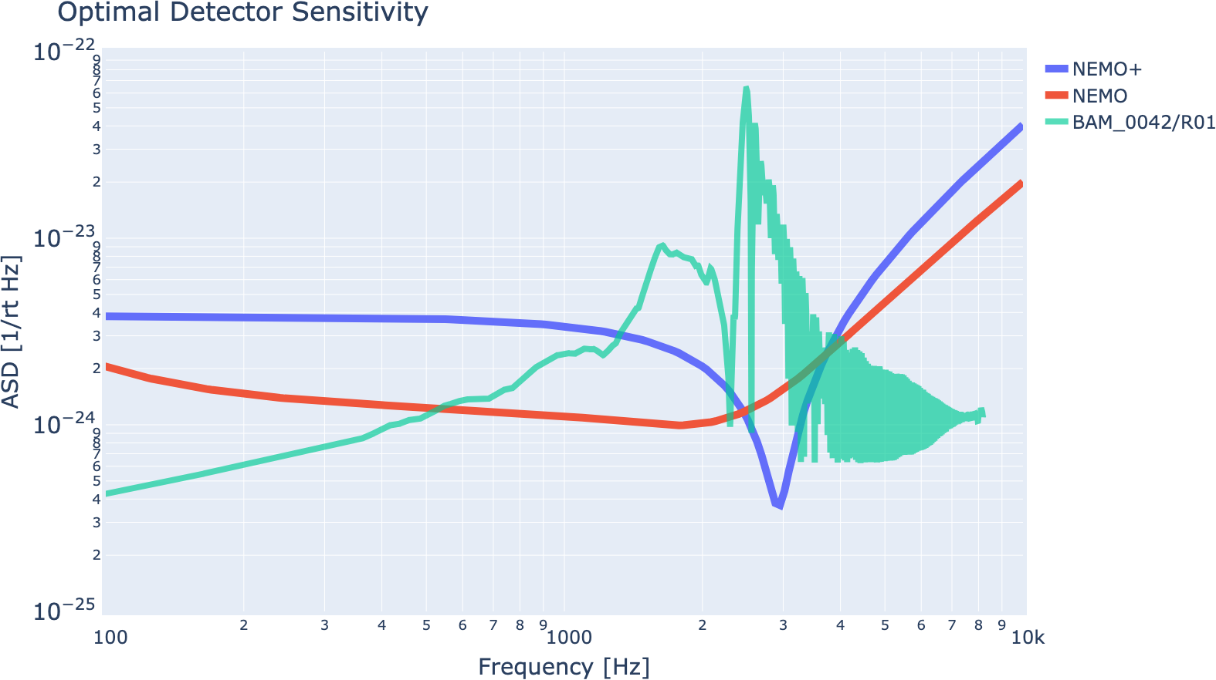
Optimising NEMO
Model detector configurations
Inject NR waveforms
Calculate detection rate
Aim Maximise BNS post-merger signal detection rate
Results
Optimal detection rate: 0.04 - 0.66 yr⁻¹ (c.f. 0.01 - 0.15 yr⁻¹) (single detector)
Uncertainty from merger rate
NEMO in network: ~10⁰ yr⁻¹
More observation runs needed

Slide 11
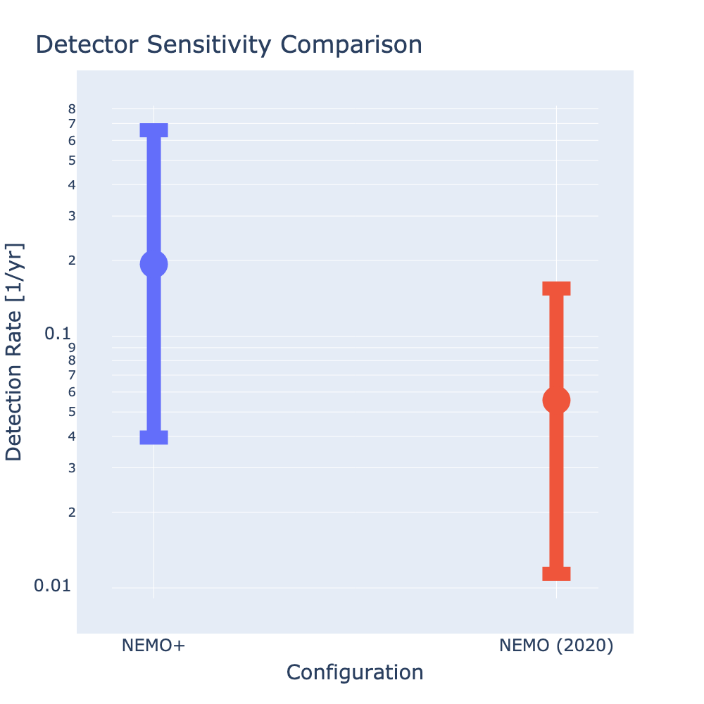
Optimising NEMO
Model detector configurations
Inject NR waveforms
Calculate detection rate
Aim Maximise BNS post-merger signal detection rate
Results
Optimal detection rate: 0.04 - 0.66 yr⁻¹ (c.f. 0.01 - 0.15 yr⁻¹) (single detector)
Uncertainty from merger rate
NEMO in network: ~10⁰ yr⁻¹
More observation runs needed

Slide 12

Summary
Further work
Homodyne readout
Other sources of noise
Nonlinear optics
Detection rate in network
Supercomputer run
Matched-filter SNR
Investigate astrophysical assumptions
Optimising distinguishability of EoS
University of Warwick/Mark Garlick, CC BY 4.0 <https://creativecommons.org/licenses/by/4.0>, via Wikimedia Commons

